Slide 1
How to Pull the CALPADS Real-Time Extracts for the Data Drilldown
Special Education Division
Data Evaluation and Analysis Unit
California Department of Education
Fall 2026
TONY THURMOND
Notes:
This video will explain how to pull the CALPADS Real-Time Extracts for use in the Improvement Data Center’s Data Drilldown tool. My name is Brandi Jauregui and I am an Information Technology Supervisor for the Data Evaluation and Analysis Unit in the Special Education Division of the California Department of Education.

Slide 2
Contact Us
Email Special Education Data questions to: speddatasupport@cde.ca.gov
Notes:
If you have any questions about this content please send an email to speddatasupport@cde.ca.gov.

Slide 3
Purpose of Video
The purpose of this video is to explain:
  each of the CALPADS file types and which data are in the file;
  how to extract the data for your LEA for use in the System Improvement Leads (SIL) Improvement Data Center (IDC) Data Drilldown tool;
  special considerations that need to be taken for each of the file types.
Notes:
The purpose of this video is to explain each of the CALPADS file types and outline the key data in each file with specific instructions and considerations on how to filter each extract for the IDC Data Drilldown tool.

Slide 4
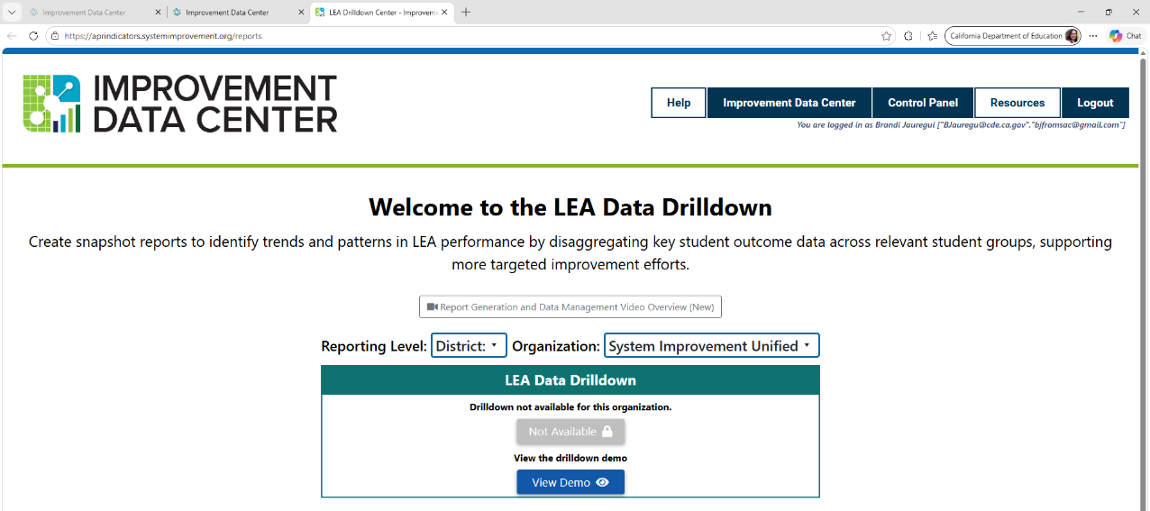
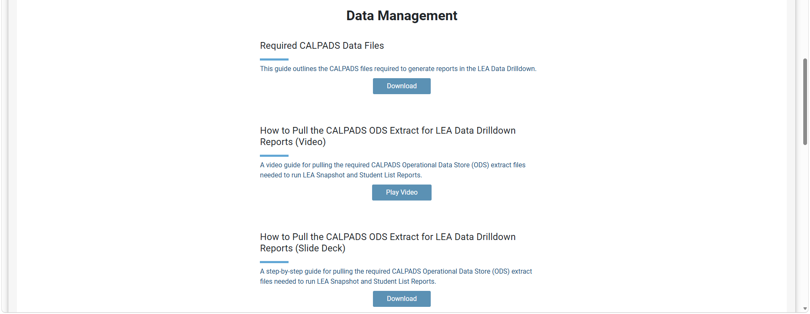
LEA Data Drilldown Center (1)
https://aprindicators.systemimprovement.org/reports
Notes:
On the System Improvement Leads website, go to the Improvement Data Center, and in the LEA Tools section, click on the LEA Data Drilldown link. To find the specific files you will need to upload, click on the “Resources” link in the top navigation bar. Then scroll down to the Data Management Section and download the “Required CALPADS Data Files” document. This link will take you to the chart on the next slide.

Slide 5
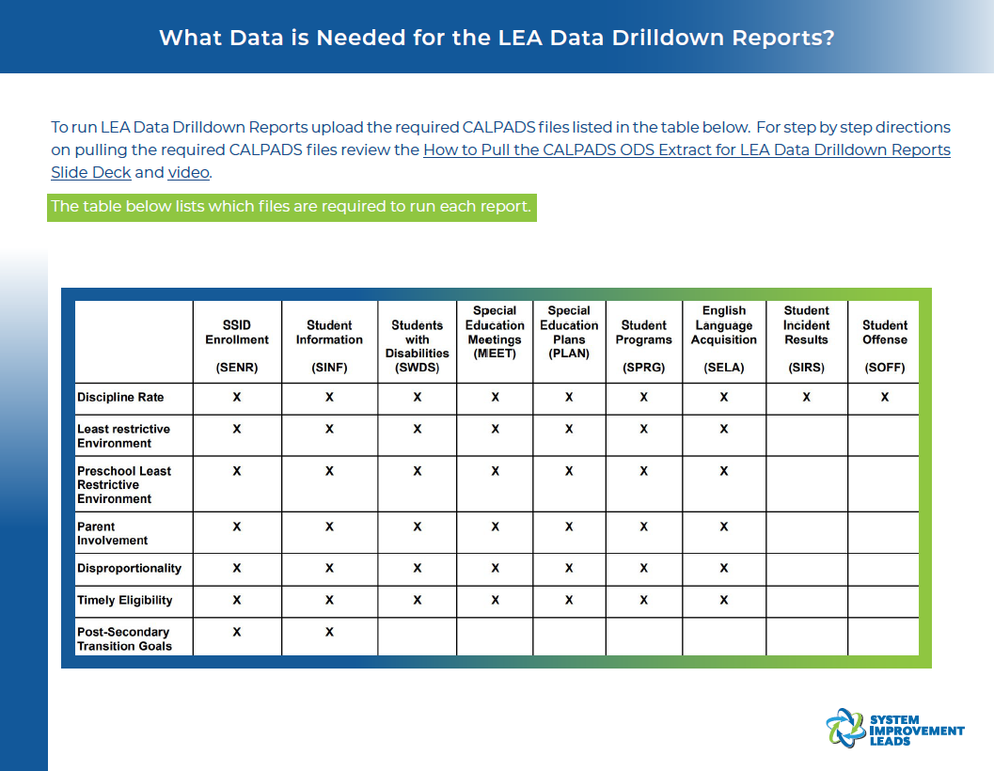
LEA Data Drilldown Center (2)
Notes:
This chart outlines the CALPADS files you will need to extract and the LEA reports in the Data Drilldown that utilize each of these files.

Slide 6
How should LEAs use the Data Drill Down Tool?
Because the data are current, and not certified, LEAs should use the Data Drill Down Tool to:
  Create snapshot reports to identify trends and patterns in LEA performance by disaggregating key student outcome data across relevant student groups, supporting more targeted improvement efforts.
The tool should NOT be used to:
  Replicate the LEA’s calculations for specific data related to the indicators in the Annual Determination Letter because the data used in the tool are real-time data, not certified data
Notes:
It is important to understand that the intent of the Data Drill Down tool is to assist LEAs in Compliance Improvement Monitoring (CIM) to create snapshot reports to identify trends and patterns in LEA performance in specific areas being monitored that are related to the California State Performance Plan Indicators. Additionally, LEAs can use the Data Drill Down Tool to monitor progress on these indicators throughout the year and across academic years.
Conversely, LEAs should NOT use the Data Drill Down Tool to try to replicate CDE’s calculations for the LEA for specific data related to the indicators that were used in the LEA’s annual monitoring determination because the data used in the tool are real-time and NOT certified.

Slide 7
What are CALPADS Real-Time Extracts?
All local educational agencies (LEAs) can extract any data they have submitted to CALPADS based on the most current real-time data in CALPADS
These extracts are CSV or text files that the LEA can request from the Extracts menu in CALPADS
The parameters of the data in each extract can be defined by the user in the filter selection screens for each extract
  These parameters will vary depending on what the LEA is trying to accomplish in the LEA Data Drilldown tool:
    Analysis of current year data; or
    Analysis of prior year data
Notes:
The data being extracted from CALPADS for the Data Drilldown are considered Real-Time data, which means that the data being extracted are the most current real-time data in the CALPADS database. These extracts are CSV files that the LEA can request using the Extracts menu option in CALPADS. Each of the extracts allows the user to specify parameters to filter the data they need. The parameters you choose will depend on whether you are trying to analyze current year data or prior year data. As we move through the specific file types, each section will cover the filter selections needed.

Slide 8
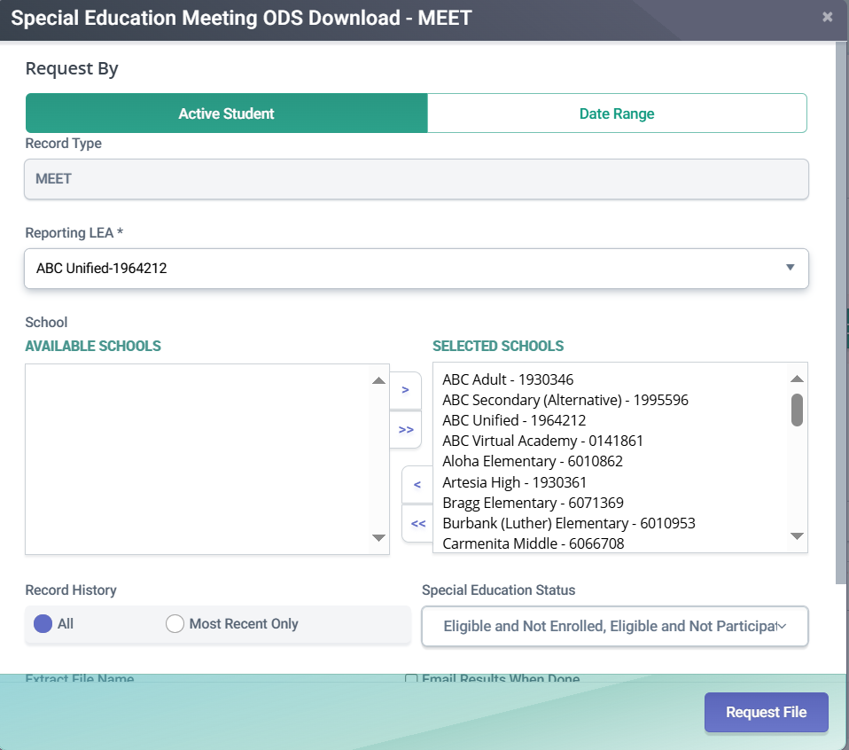
Should LEAs ever use the “Active Student” filter option?
Using the “Active Student” option will ONLY extract students who are actively enrolled based on the date the extract is being requested; therefore we do not recommend downloading these extracts using the “Active Student” filter option for purposes of the IDC Data Drilldown
Notes:
Nearly every extract will give LEAs the option to select “Active Students”. Selecting this option will only give you students enrolled at the LEA on the day you generate the extract; therefore, we do not recommend that you use the Active Students filter for purposes of the Data Drilldown.

Slide 9
Standard Extract Filter Options
Users can specify parameters for the data set they are requesting
There are some parameters that you should always set the same way when requesting any of the extracts discussed in this presentation:
  Always select the Date Range Tab rather than the Active Student Tab (discussed on the prior slide)
  Only select non-charter schools because all charter schools receive their own individual monitoring determinations
  Only select most recent records (not entire history)
  When populating Enrollment Start and End Dates for current or prior year extracts, use 7/1 as the start date, and 6/30 as the end date
    Remember for current year extracts that if you’re extracting data mid-year, the extract will only include students who are enrolled up to the current date
Notes:
When requesting extracts, users can specify parameters for the data set they are requesting in the extract screen. There are some parameters that should be set the exact same way for every extract discussed in this presentation. For example:
Always select the Date Range Tab rather than the Active Student Tab (discussed on the prior slide).
When selecting the schools to include in your extract, only select non-charter schools because all charter schools receive their own individual monitoring determinations and are excluded from their authorizing district’s calculations
For MOST extracts, only select most recent records (not entire history) – selecting all historical records will result in multiple records for each student which may skew the results that the tool provides
Finally, when populating Enrollment Start and End Dates for current or prior year extracts, always use 7/1 as the start date and 6/30 as the end date. Keep in mind that for current year extracts, if you’re extracting the files mid-year, the extract will only include students who are enrolled up to the current date.

Slide 10
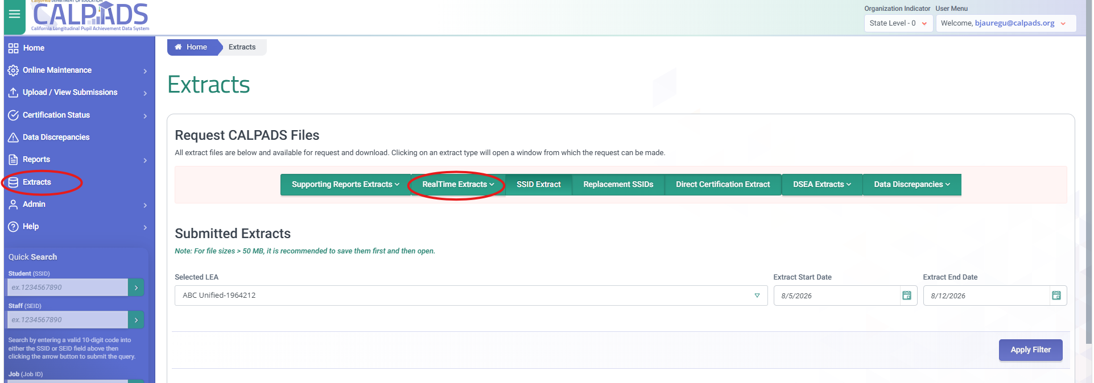
CALPADS Extract Screen
Notes:
To find the CALPADS Extracts Screen, after logging in to CALPADS, click the extracts option in the left-hand menu bar. Then click on the Real-time Extracts button to select a specific extract. The remaining slides in this presentation will give you specific instructions on extracting each of the file types required for the Data Drilldown.

Slide 11
SSID Enrollment (SENR) Extract
Notes:
This section will explain how to extract the SSID Enrollment (SENR) Extract from CALPADS for use in the IDC Data Drilldown tool.

Slide 12
SENR Purpose and Contents
Identifies students enrolled at the LEA for the user-specified period of time
Includes both general education and students with disabilities
Notes:
The SENR file identifies students enrolled at the LEA for a user-specified period of time and includes both general education and students with disabilities

Slide 13
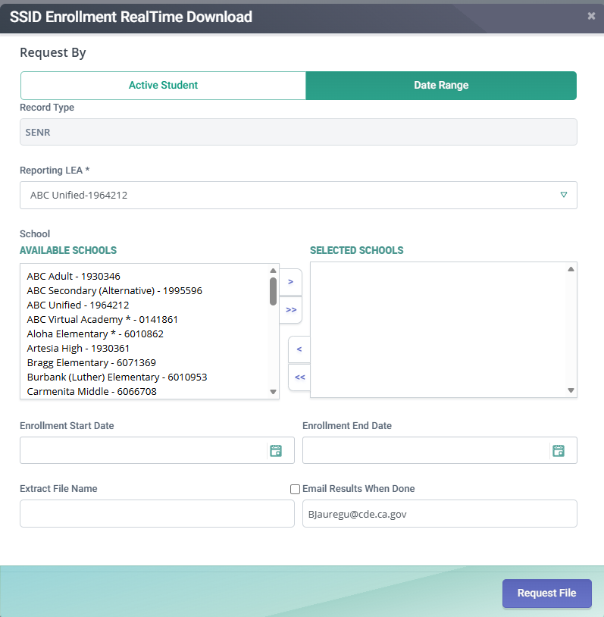
SENR Extract Screen
Extract Filter Selections:
  Select the Date Range tab
  Select the applicable schools and remember to EXCLUDE ALL CHARTERS
  Use an Enrollment Start Date of 7/1 of the current academic year and an Enrollment End Date of 6/30 of the current or prior year.
Notes:
In the Real-time Extracts menu, select the SSID Enrollment RealTime download. Apply the standard filter selections as discussed on the Standard Extract Filter Options slide, then click Request File.

Slide 14
Student Information (SINF) Extract
Notes:
This section will explain how to extract the Student Information Enrollment (SINF) RealTime Extract from CALPADS for use in the IDC Data Drilldown tool.

Slide 15
SINF Purpose and Contents
Identifies demographic data (e.g. gender, race/ethnicity, birthdate, etc.) for students enrolled at the LEA for the user-specified period of time
Includes both general education and students with disabilities
Notes:
The SINF file identifies demographic data such as gender, race/ethnicity, and birthdates for students enrolled at the LEA for the user-specified period of time and includes data for both general education students and students with disabilities.

Slide 16
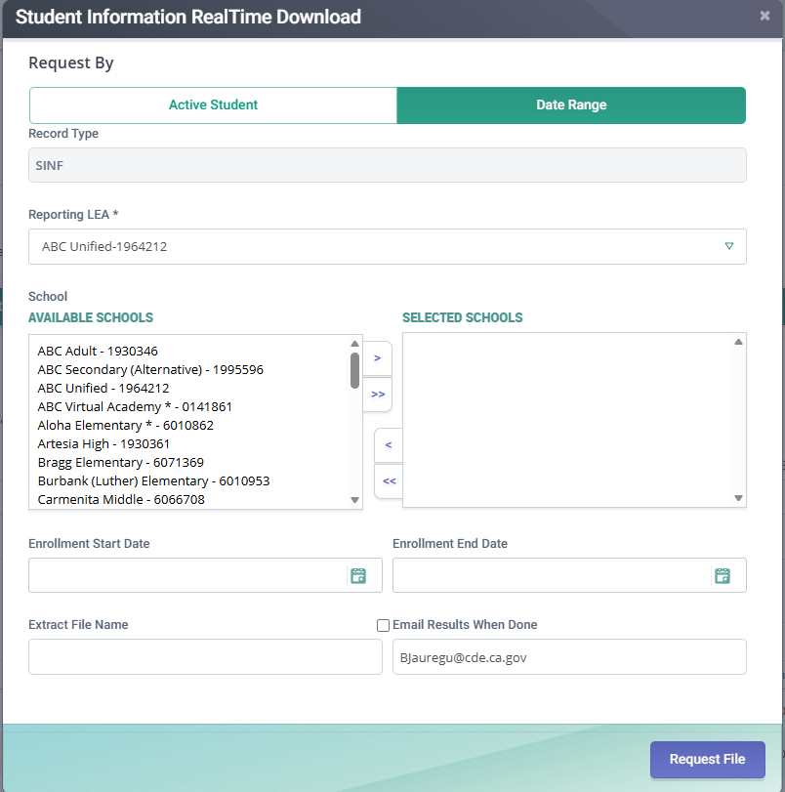
SINF Extract Screen
Extract Filter Selections:
  Select the Date Range tab
  Select the applicable schools and remember to EXCLUDE ALL CHARTERS
  Use an Enrollment Start Date of 7/1 of the current academic year and an Enrollment End Date of 6/30 of the current or prior year.
Notes:
In the RealTime Extracts menu, select the Student Information (SINF) RealTime download. Apply the standard filter selections as discussed on the Standard Extract Filter Options slide, then click Request File.

Slide 17
Students with Disabilities Status (SWDS) Extract
Notes:
This section will explain how to extract the Students with Disabilities Status (SWDS) Extract from CALPADS for use in the IDC Data Drilldown tool.

Slide 18
SWDS Purpose and Contents
Identifies the Special Education Status and Non-participation Reason (if applicable) for students enrolled at the LEA for the user-specified period of time
Includes ONLY students who:
  Are actively eligible and participating in special education; or
  Were evaluated for special education but not participating for various reasons; or
  Were eligible and participating in special education but have exited the program for various reasons
Notes:
The SWDS file identifies the Special Education Status and Non-participation Reason (if applicable) for students enrolled at the LEA for the user-specified period of time. This file includes only students who were actively participating in special education, were evaluated for special education but did not participate for various reasons, or were eligible and participating in special education but have exited the program for various reasons

Slide 19
SWDS – Things to note…
LEAs must extract SEPARATE FILES for:
  Students who have SWDS records with overlapping enrollments
  Students who have SWDS records with NO overlapping enrollments
    E.g., preschool age students evaluated and found ineligible who are not enrolled in a preschool program or private school students who were evaluated but found ineligible or parents declined
These files must be extracted separately because students who have SWDS records with overlapping enrollments can be extracted using enrollment start and end dates;
However, students who do not participate in special education are NOT REQUIRED to have enrollments and have SWDS records with no overlapping enrollments; therefore, the data must be extracted using the SWDS Effective Date
For purposes of the IDC Data Drilldown you should only download a file with Students who have SWDS records with overlapping enrollments
Notes:
A couple of things to take into consideration when extracting the SWDS file. LEAs have the ability to extract two separate files: One for students with overlapping enrollment records at the LEA and another for students with no overlapping enrollments. For example, some preschool students who are not enrolled in a preschool program but are evaluated for special education services and found ineligible or are found eligible and the parent declined services. In these cases, the students will have a SWDS record but may NOT have overlapping enrollments.
The two sets of data must be extracted separately because students who have SWDS records with overlapping enrollments can be extracted using enrollment start and end dates while students who do not participate in special education are NOT REQUIRED to have enrollments and have SWDS records with no overlapping enrollments; therefore, the data must be extracted using the SWDS Effective Date.
For purposes of the Data Drilldown you should only download a file with Students who have SWDS records with overlapping enrollments because most reports are intended for students participating in special education.

Slide 20
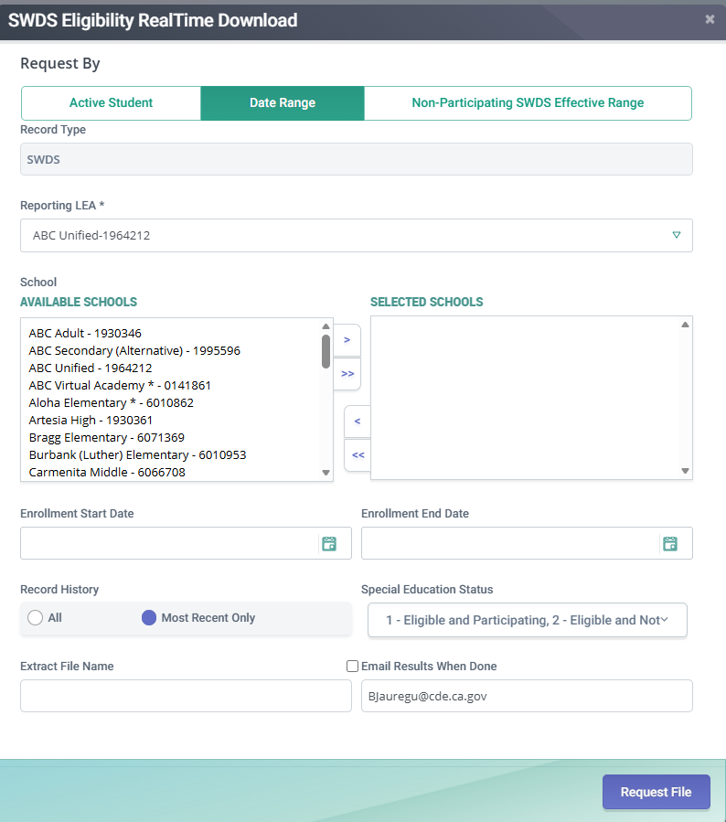
SWDS Extract Screen– SWDS w/overlapping enrollment
Extract Filter Selections:
  Select the Date Range tab
  Select the applicable schools and remember to EXCLUDE ALL CHARTERS
  Use an Enrollment Start Date of 7/1 of the current academic year and an Enrollment End Date of 6/30 of the current or prior year.
  This will ONLY give you students who have a SWDS record with an overlapping enrollment
Notes:
In the RealTime Extracts menu, select the Students with Disabilities Status (SWDS) Realtime download Apply the standard filter selections as discussed on the Standard Extract Filter Options slide. Then click Request File. Remember that this will only give you students with a SWDS record with an overlapping enrollment.

Slide 21
Special Education Meetings (MEET) Extract
Notes:
This section will explain how to extract the Special Education Meetings (MEET) Extract from CALPADS for use in the IDC Data Drilldown tool.

Slide 22
MEET Purpose and Contents
Captures all information about statutorily-required meetings for compliance purposes for IDEA including:
  Part C and Part B Initial Evaluations
  Annual Plan Reviews
  Triennial Eligibility Reevaluations
LEAs may additionally report meetings that have not yet occurred and are pending with associated Meeting Delay Reason Codes (if applicable)
Includes students who:
  Had enrollments at the LEA within the specified date range; and
  Who had a statutorily-required meeting take placed; or
  Had a statutorily-required meeting that was/is pending
Notes:
The MEET file captures information on statutory meetings required for IDEA compliance including:
Part C and Part B Initial Evaluations
Annual Plan Reviews
Triennial Eligibility Reevaluations
The MEET file is also used to collect information on statutory meetings that are pending and may be delayed for various reasons.
This extract includes students who:
Had enrollments at the LEA within the specified date range; and
Who had a statutorily-required meeting take placed; or
Had a statutorily-required meeting that was/is pending

Slide 23
MEET – Things to note…
Students will only show up in this extract if the LEA had an enrollment for the student
Because an enrollment at the LEA is not required to submit a MEET record, any student with MEET records but no enrollment at the LEA will NOT appear in this extract
Notes:
Please note that Students will only show up in this extract if the LEA had an enrollment for the student. Unlike other special education files, the MEET file does NOT require that the student be enrolled at the LEA on the date of the meeting, so any meetings reported by the LEA without an overlapping enrollment will not appear in this extract.

Slide 24
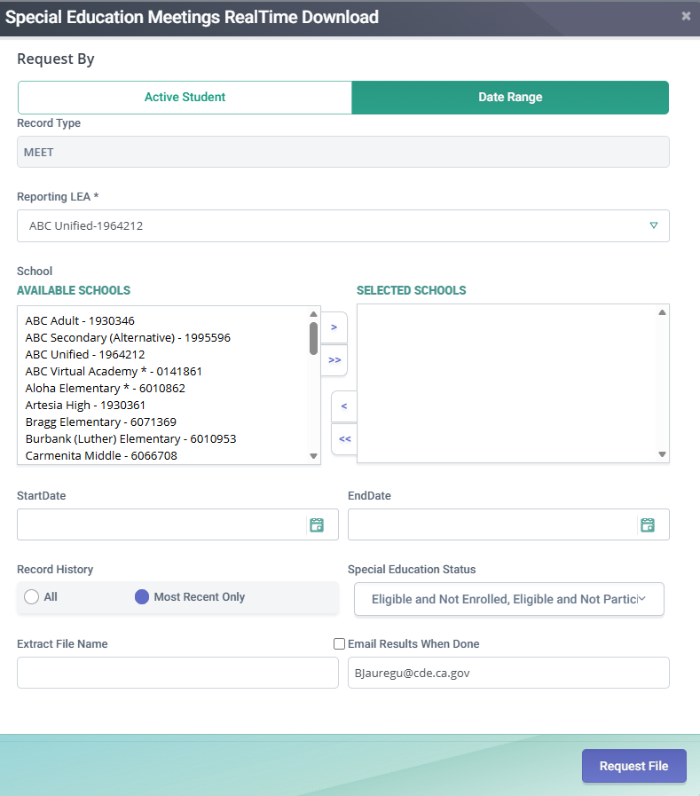
MEET Extract Screen
Extract Filter Selections:
  Select the Date Range tab
  Select the applicable schools and remember to EXCLUDE ALL CHARTERS
  Use an Enrollment Start Date of 7/1 of the current academic year and an Enrollment End Date of 6/30 of the current or prior year.
  Select “All” in Record History
  Select all for Special Education Status
  This will ONLY give you students who have MEET records who had an enrollment at the LEA during the specified time period
Notes:
In the RealTime Extracts menu, select the Special Education Meetings (MEET) Realtime download. Apply the standard filter selections as discussed on the Standard Extract Filter Options slide. Select “All” in Record history (this will give you a history of all meetings for students, even if they were reported by other LEAs) and “All” for Special education status. Then click Request File. Remember that this will only give you students with a MEET record with an overlapping enrollment at your LEA.

Slide 25
Special Education Plan (PLAN) Extract
Notes:
This section will explain how to extract the Special Education Plan (PLAN) Extract from CALPADS for use in the IDC Data Drilldown tool.

Slide 26
PLAN Purpose and Contents
Captures all special education plan data for students enrolled in the user-specified time period.
  Individualized Education Program (IEP)
  Individualized Service Plan (ISP)
  Individualized Family Service Plan (IFSP)
Includes only students with disabilities who at one point were eligible and participating in special education and had a PLAN record
Notes:
The PLAN file Captures all special education plan data for students enrolled in the user-specified time period. Special education plans include:
Individualized Education Program (IEP)
Individualized Service Plan (ISP)
Individualized Family Service Plan (IFSP)
The extract will only include students with disabilities who at one point were eligible and participating in special education and had a PLAN record

Slide 27
PLAN – Things to note…
Students will only show up in this extract if the LEA had an enrollment for the student during the user-specified period of time
LEAs have the option to download the student’s plan history (including plans from prior LEAs) or only the most recent plan
For purposes of the IDC Drilldown Tool, LEAs should filter the extract to include ONLY THE MOST RECENT PLANS
Notes:
Please note that Students will only show up in this extract if the LEA had an enrollment for the student during the user-specified period of time. There is an option in the filter selection criteria to include the students’ entire plan history (including plans from other LEAs), however for purposes of the Drilldown tool, make the selection for only the most recent plan for each student.

Slide 28
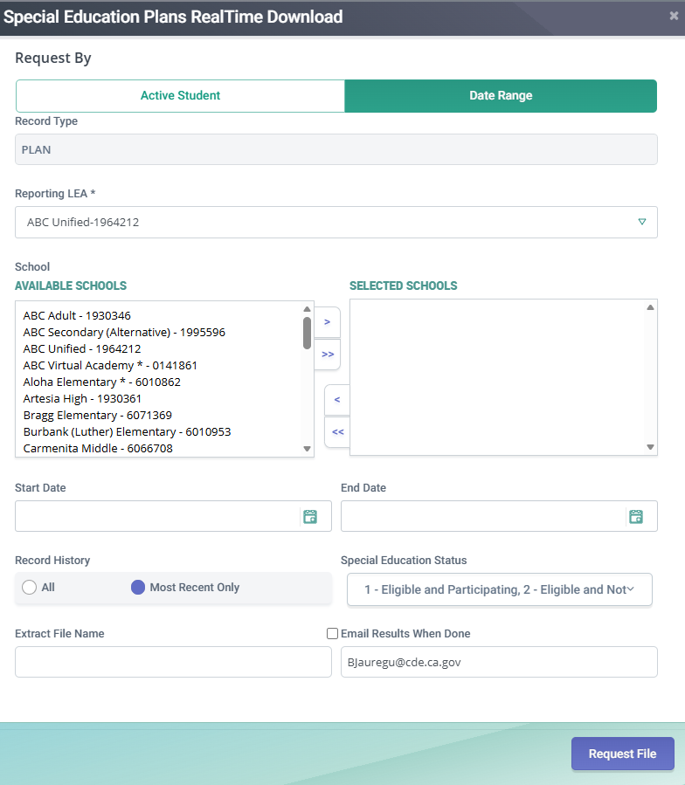
PLAN Extract Screen
Extract Filter Selections:
  Select the Date Range tab
  Select the applicable schools and remember to EXCLUDE ALL CHARTERS
  Use an Enrollment Start Date of 7/1 of the current academic year and an Enrollment End Date of 6/30 of the current or prior year.
  Select “Most Recent Only” in Record History
  Select all for Special Education Status
Notes:
In the RealTime Extracts menu, select the Special Education Plan (PLAN) Realtime download. Apply the standard filter selections as discussed on the Standard Extract Filter Options slide. Select “Most Recent Only” in Record history and “All” for Special education status. Then click Request File.

Slide 29
Student Program (SPRG) Extract
Notes:
This section will explain how to extract the Student Program (SPRG) Extract from CALPADS for use in the IDC Data Drilldown tool.

Slide 30
SPRG Purpose and Contents
Captures student eligibility and participation in specific education programs. See the CALPADS Code Set “Education Program Code” for a comprehensive list of programs.
CALPADS System Documentation page at: https://www.cde.ca.gov/ds/sp/cl/systemdocs.asp
Includes students with disabilities and general education students
Notes:
The SPRG file captures student eligibility and participation in specific education programs. For a comprehensive list of Education Programs that are captured in CALPADS, see the CALPADS Code Set document and reference the Code Set named “Education Program Code”. The document can be found on the CALPADS System Documentation page at: https://www.cde.ca.gov/ds/sp/cl/systemdocs.asp.
This file contains program data for students with disabilities and general education students

Slide 31
SPRG – Things to note…
Students will only show up in this extract if the LEA had an enrollment for the student within the specified time period
IMPORTANT: This extract will provide ALL SPRG records for enrolled students, even if the student is no longer eligible or participating in the program. To capture CURRENT or PRIOR YEAR program participation you will need to filter the extract results by the program start and end dates after you have downloaded the results
Notes:
Please note that Students will only show up in this extract if the LEA had an enrollment for the student within the specified time period. It’s also important to understand that this extract will provide ALL program records for enrolled students, even if the student is no longer eligible or participating in the program. To capture CURRENT or PRIOR YEAR program participation you will need to filter the extract results by the program start and end dates AFTER you have downloaded the results

Slide 32
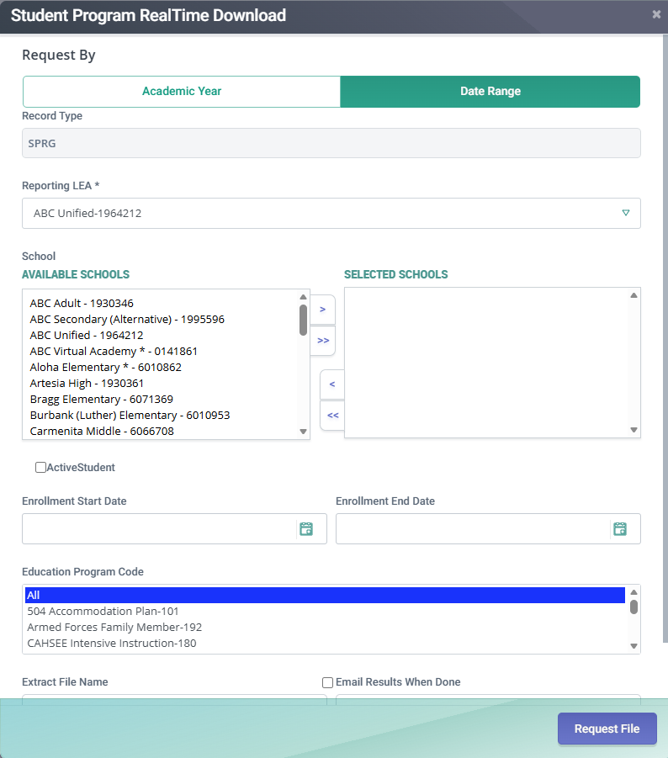
SPRG Extract Screen
Extract Filter Selections:
  Select the Date Range tab
  Select the applicable schools and remember to EXCLUDE ALL CHARTERS
  Use an Enrollment Start Date of 7/1 of the current academic year and an Enrollment End Date of 6/30 of the current or prior year.
  Select “All” Education Programs
  This will ONLY give you students who have SPRG records who had an enrollment at the LEA during the specified time period
Notes:
In the RealTime Extracts menu, select the Student Program (SPRG) Realtime download. Apply the standard filter selections as discussed on the Standard Extract Filter Options slide. Select “All” in Education Programs. Then click Request File.

Slide 33
Student English Language Acquisition (SELA) Extract
Notes:
This section will explain how to extract the Student English Language Acquisition (SELA) Extract from CALPADS for use in the IDC Data Drilldown tool.

Slide 34
SELA Purpose and Contents
Captures a student’s English language acquisition status for students enrolled during the specified time period
This file contains students with disabilities and general education students
Notes:
The SELA file captures a student’s English language acquisition status for students enrolled during the specified time period, for example, the date the student was identified as an English learner, or the date the student was reclassified fluent English proficient.
This file contains students with disabilities and general education students

Slide 35
SELA – Things to note…
Students will only show up in this extract if the LEA had an enrollment for the student within the specified time period
Any student with a preschool (PS) or transitional kindergarten (TK) will not be included because these grade levels are not eligible to take the Initial English Language Proficiency Assessments for California (ELPAC). Only Kindergarten through grade 12 students are eligible.
Notes:
Please note that will only show up in this extract if the LEA had an enrollment for the student within the specified time period. Additionally, because preschool and transitional kindergarten students are not eligible to take the English Language Proficiency Assessments for California (ELPAC), this extract will ONLY produce records for students in grades Kindergarten through 12.

Slide 36
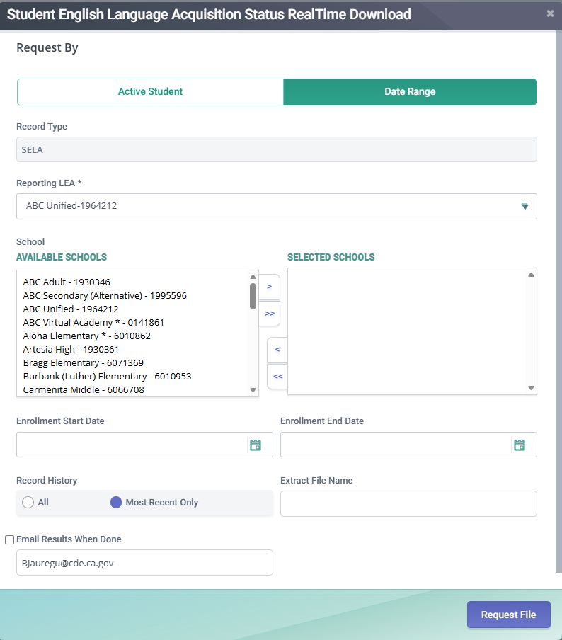
SELA Extract Screen
Extract Filter Selections:
  Select the Date Range tab
  Select the applicable schools and remember to EXCLUDE ALL CHARTERS
  Use an Enrollment Start Date of 7/1 of the current academic year and an Enrollment End Date of 6/30 of the current or prior year
  Select “Most Recent Only” for Record History
  This will give you the student’s most recent ELA status within their enrollment
Notes:
In the Realtime Extracts menu, select the Student English Language Acquisition Status (SELA) Realtime download. Apply the standard filter selections as discussed on the Standard Extract Filter Options slide. Select “Most recent only” in Record History. Then click Request File.

Slide 37
Student Incident Results (SIRS) Extract
Notes:
This section will explain how to extract the Student Incident Results (SIRS) Extract from CALPADS for use in the IDC Data Drilldown tool.

Slide 38
SIRS Purpose and Contents
Captures all of the results (dispositions, disciplinary actions) for a specific incident for a student.
  A student may have multiple incident results for one incident (e.g., a student is involved in an incident on a specific date. The student receives in-school suspension for three days and 10 days out-of-school suspension. This student would have two incident results for this incident.
Contains students with disabilities as well as general education students.
Notes:
The SIRS file captures all of the results (also known as dispositions, disciplinary actions) for a specific incident for a student. A student may have multiple incident results for one incident (e.g., a student is involved in an incident on a specific date. The student receives in-school suspension for three days and 10 days out-of-school suspension. This student would have two incident results for this incident.
This file contains students with disabilities as well as general education students.

Slide 39
SIRS – Things to note…
This extract will give you all incident results for students reported by the LEA during the specified time period.
Although this extract contains ALL incident results – the only results that are used for purposes of the Data Drilldown tool are in- and out-of-school suspensions and expulsions.
Only results for students who were students with disabilities on the DATE OF THE INCIDENT are counted for purposes of the State Performance Plan/Annual Performance Report
  The Incident Date is captured in the Student Incident (SINC) file which is NOT currently uploaded to the Data Drilldown tool
Notes:
Please note that this extract will give you all incident results for students reported by the LEA during the specified time period.
An incident is defined as an event (usually requiring disciplinary action) involving one or more students on a specific date. Although this extract contains ALL incident results – the only results that are used for purposes of the Data Drilldown are in- and out-of-school suspensions and expulsions.
Additionally, when data are calculated at the state level, only results for students who were students with disabilities on the DATE OF THE INCIDENT are counted for purposes of the State Performance Plan/Annual Performance Report. The Incident Date is captured in the Student Incident (SINC) file which is NOT currently uploaded to the Data Drilldown tool

Slide 40
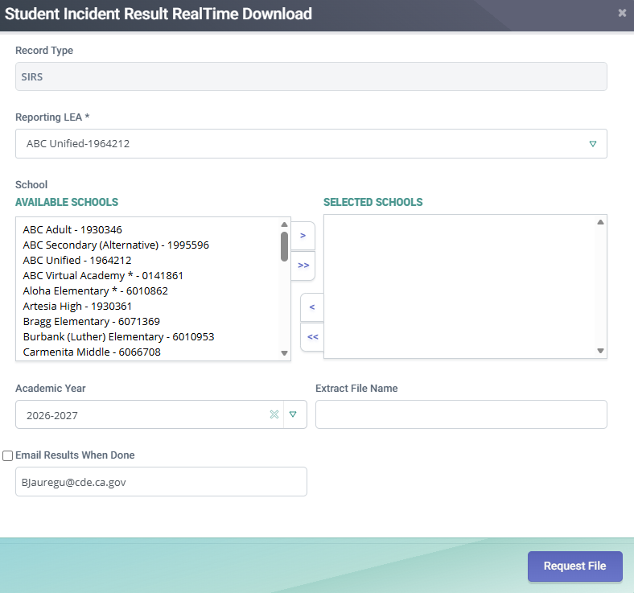
SIRS Extract Screen
Extract Filter Selections:
  Select the applicable schools and remember to EXCLUDE ALL CHARTERS
  Specify the current or prior academic year
  This will give you all incident results for students reported by the LEA during the specified academic year
Notes:
In the Realtime Extracts menu, select the Student Incident Result (SIRS) Realtime download. Apply the standard filter selections as discussed on the Standard Extract Filter Options slide. Select the current or prior year academic year in the Academic Year section. Then click Request File.

Slide 41
Student Offense (SOFF) Extract
Notes:
This section will explain how to extract the Student Offense (SOFF) Extract from CALPADS for use in the IDC Data Drilldown tool.

Slide 42
SOFF Purpose and Contents
Captures all of the statutory offenses outlined in Education Code Sections 48900 and 48915 for a specific incident for a student.
  A student may have multiple offenses for one incident
Contains students with disabilities as well as general education students.
Notes:
The SOFF file captures all of the statutory offenses outlined in Education Code Sections 48900 and 48915 for a specific incident for a student.
A student may have multiple offenses for one incident
This file contains students with disabilities as well as general education students.

Slide 43
SOFF – Things to note…
This extract will give you all student offenses for students reported by the LEA during the specified academic year.
Only students whose incidents involved statutory offenses are included in this extract.
Notes:
Please note that this extract will give you all student offenses for students reported by the LEA during the specified academic year.
Because some incidents are not required to be affiliated with a statutory offense (specifically incidents resulting in restraint or seclusion that are not affiliated with an Ed Code violation), only students whose incidents involved statutory offenses are included in this extract.

Slide 44
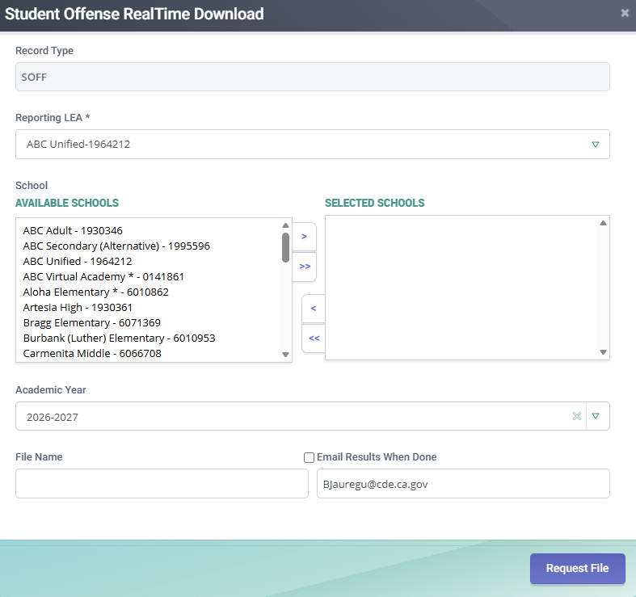
SOFF Extract Screen
Extract Filter Selections:
  Select the applicable schools and remember to EXCLUDE ALL CHARTERS
  Specify the current or prior academic year
  This will give you all incident results for students reported by the LEA during the specified academic year
Notes:
In the RealTime Extracts menu, select the Student Offense (SOFF) RealTime download. Apply the standard filter selections as discussed on the Standard Extract Filter Options slide. Select the current or prior academic year in the Academic Year section. Then click Request File.

Slide 45
Resources
CALPADS User Manual – RealTime Extract Documentation:
  https://documentation.calpads.org/Extracts/RealTimeExtract/#realtime-extracts
Notes:
The CALPADS User Manual contains specific information about each of the RealTime Extracts. This documentation can be found at the following link:
https://documentation.calpads.org/Extracts/RealTimeExtract/#realtime-extracts
Thank you for watching! Please feel free to reach out to speddatasupport@cde.ca.gov if you have specific questions about these extracts or information in this presentation.

